Slide 1
HEALTH SCORE PREDICTOR
Group 06
Data science with python

Slide 2
Problem and Motivation
Data Source
Notebook map
Data Exploration
Feature Engineering
Balancing and building dataset
Model
Results and Insights

Slide 3
Problem and Motivation
Limited inspection bandwidth leads to reactive scheduling high risk restaurants are often found late due to fragmented data and manual heuristics.
Future outcomes (pass/fail/conditional) depend on historical violations, time since last inspection, neighborhood risk, and inspection type hard to weigh consistently without a predictive tool.
City agencies lack a unified, data‑driven way to prioritize inspections, risking missed hotspots and inefficient routes.
Use SF health inspections plus public signals (Google ratings) to forecast violation risk and proactively target HIGH‑risk establishments.
Provide an inspector‑facing dashboard with trends, neighborhood risk, and per‑business predictions to inform scheduling and resource allocation.
Demonstrate ML (RF or XGBoost) can outperform baseline heuristics, improving public health outcomes and fairness with transparent, data‑backed decisions.

Slide 4

Data Source
SF Health Inspections (2020–Present):
Primary labeled records of inspections, violations, and outcomes. These are the raw records which are found separately in the SF health department website data.sfgov.org/Health-and-Social-Services
HealthInspection(2020-2023).csv HealthInspection(2024-present).csv
Google Places Signals:
Ratings and review counts to proxy hygiene perception. This data is extracted using Google cloud API: Geocoding API and Places API.
Google_clean.csv
Neighborhood Crosswalk:
Mapping neighborhoods/ZIPs for spatial features and one‑hot encoding. Cleaned up dataset for visualization and model run
model_dataset.csv

Slide 5

Notebooks Map
HEALTHSCORE-PREDICTOR
BACKEND – Consists of the End points, Data inputs and Model serving
DASHBOARD – React frontend framework for visualization and user interaction.
DATA/CLEAN – PreProcessed csv file useful for the model run and visual ease
DATA/RAW – Untouch dataset extracted.
NOTEBOOKS/DATACLEANING – Data cleaning, standardizing, schema-aligned datasets ready for EDA, modeling, and the dashboard.a
NOTEBOOKS/MODEL – Execution of our chosen model over the built dataset
BACKEND
DASHBOARD
DATA
CLEAN
RAW
NOTEBOOKS
DATA CLEANING
MODEL

Slide 6
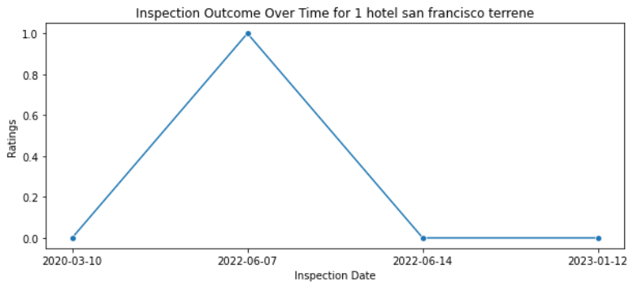
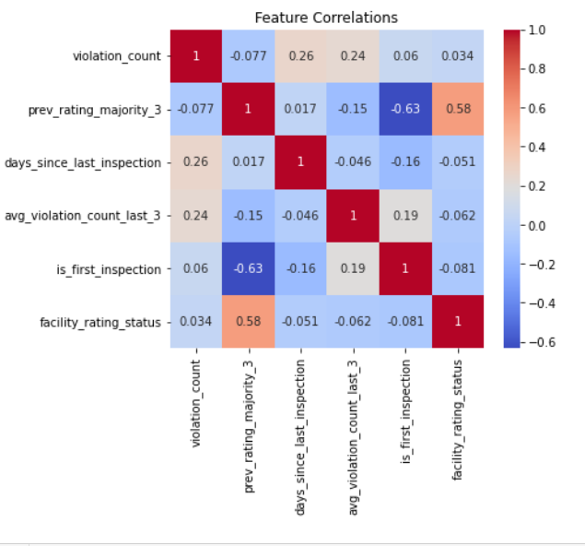
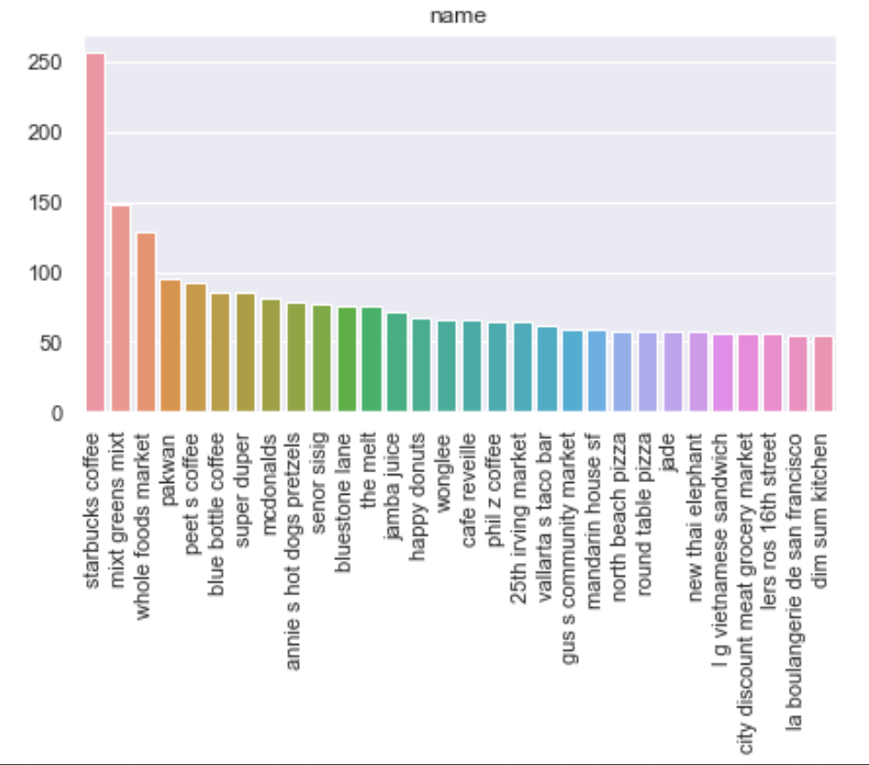
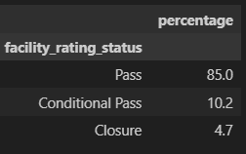
Data Exploration

Slide 7
Data Cleaning and Feature Engineering
Text normalization
Column names:
Standardized to lowercase with underscores
String trimming:
Removed leading/trailing spaces in all text columns.
Address & name canonicalization:
Added canonical names dress by normalizing suffixes, removing unit markers, and slugifying text.
Corrections:
Standardized facility status variants
(typos in “Conditional Pass”).
Recent rating:
Most common inspection outcome across the last three inspections for the same facility.
Recent Violation:
Average number of violations over the previous three inspections.
Inspection gap (in days):
Elapsed time in days since the facility’s previous inspection.
First Inspection : Yes or NO.
Imputation & Null handling
Violations (2024):
Imputed violation_count missing to 0 imputed violation_codes
missing to empty string.
Violations (merged):
Filled violation_count missing to 0 and created has_violation_count to differentiate two datasets
Lat and Log impute:
Data extracted from google_data and imputed for missing lat and log
Merging & Alignment (2020 vs 2024)
Column alignment:
Renamed 2020 columns to match 2024 schema
Column pruning:
Dropped administrative/geospatial columns not needed for modeling (e.g., inspector, district, point, etc.).
Dataset merge:
Concatenated aligned 2020 and 2024 frames into df_merge.
Feature Engineering

Slide 8
Handling Imbalance
Balancing Techniques Evaluated
SMOTE
BorderlineSMOTE
Random Over-Sampling
Random Under-Sampling
Model-Based Imbalance Handling
class_weight used in Random Forest
sample_weight used in XGBoost
Key Observations
Using class weights on the original dataset outperformed methods that introduced synthetic data
Random Under-Sampling produced results similar to the original dataset
Over-sampling and SMOTE degraded model performance Synthetic data introduced noise
Led to poorer generalization

Slide 9
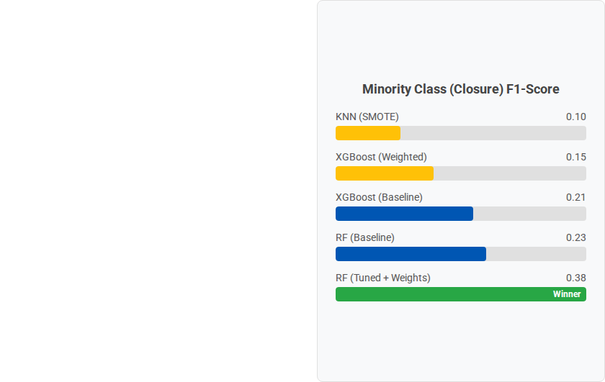
Model Benchmarking
The Challenge: Class Imbalance
The dataset is heavily skewed towards "Pass" ratings. Detecting "Closures" (Class 2) is difficult but critical for public safety.
Selection Rationale
XGBoost (Baseline): High accuracy (90%) but failed to detect closures (Recall ~0.25).
RF (Undersampling): Improved recall but lost too much training data.
Winner: RF (Tuned + Weights): We used custom class weights {0:1, 1:2, 2:4}. This provided the best balance of stability and precision.

Slide 10
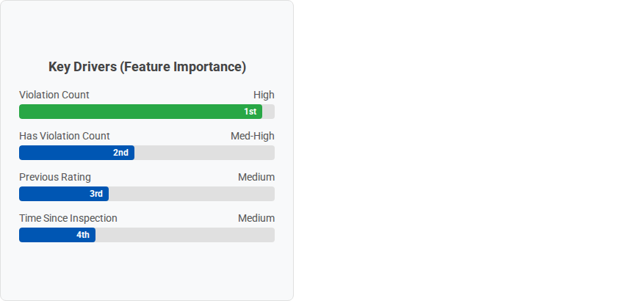

Results & Strategic Insights
94.1%
0.85
0.68
OVERALL ACCURACY
CLOSURE PRECISION
OPTIMAL THRESHOLD
Business Recommendations
Prioritize Risk: The sheer volume of current violations is the #1 predictor. Facilities with high violation counts should trigger immediate senior officer review.
History Matters: Past performance is predictive. "Conditional Pass" history correlates with future Closures.
Deployment: Use the model to flag "At-Risk" facilities before inspection to allocate resources efficiently.

Slide 11


